Slide 1


Introduction to
Robotic Process Automation
EXCEL-TO-CERTIFICATE AUTOMATION
220701114
Kaaviya G
Mrs. J. Jinu Sophia
Assistant Professor(SG)

Slide 2
Abstract
This RPA project in UiPath Studio automates the generation of participation certificates by leveraging data from an Excel sheet and a PowerPoint certificate template. The process begins with reading participant details, such as names, from the Excel file. For each entry, the bot opens the PowerPoint template, dynamically replaces placeholders with the participant's information, and exports the customized certificate as a PDF file. This ensures an efficient, accurate, and scalable solution for bulk certificate creation, eliminating manual errors and saving significant time. The final certificates are stored in a designated folder, ready for distribution.

Slide 3
Need for the Proposed System
Manually generating participation certificates for large events or training sessions is a repetitive, time-consuming, and error-prone task. The proposed system addresses these challenges by automating the certificate creation process, ensuring accuracy, uniformity, and efficiency. It eliminates the need for manual data entry and formatting, reducing the risk of errors such as misspelled names or incorrect details. Additionally, the system can handle large volumes of data quickly, making it ideal for events with numerous participants. By leveraging RPA, organizations can save significant time and resources, streamline their operations, and focus on more strategic activities.

Slide 4
Advantages of the Proposed System
Time Efficiency: Automates the repetitive process of certificate generation, significantly reducing the time required for creating certificates manually.
Accuracy and Consistency: Ensures uniform formatting and eliminates human errors in the participant details, such as names and other dynamic fields.
Scalability: Capable of processing a large number of certificates efficiently, making it ideal for events or programs with numerous participants.
Cost-Effective: Reduces the need for manual labor, thereby lowering operational costs associated with certificate creation.
Ease of Use: Requires minimal user intervention once set up, allowing the process to run seamlessly.

Slide 5
Literature Survey
Title: Automation of Document Generation Using Robotic Process Automation
Advantages:
Demonstrates significant time savings for bulk document generation.
High accuracy due to automated data handling and integration.
Disadvantages:
Limited focus on error handling when template placeholders are incorrectly defined.
Title: Enhancing Event Management Through Automated Certificate Generation
Advantages:
Tailored specifically for event-based scenarios, showcasing real-world use cases.
Disadvantages:
The setup process is time-intensive, requiring detailed template customization.

Slide 6
Main Objective
The primary objective of the proposed system is to automate the generation of participation certificates by integrating participant data from an Excel sheet with a pre-designed PowerPoint template. The system aims to streamline the certificate creation process, ensuring efficiency, accuracy, and consistency while eliminating the need for manual intervention. This automation is designed to handle large-scale certificate production quickly and reliably, producing professional-quality PDF certificates ready for distribution.

Slide 7
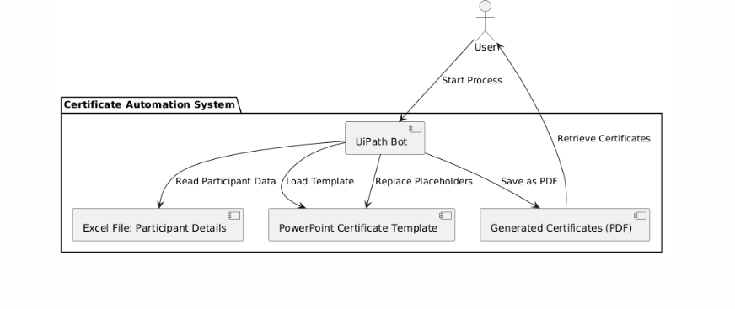
Architecture

Slide 8
System Requirements
Hardware
Processor:Minimun Intel i5
RAM:Minimum 8GB
Storage:Minimum 20 GB for UiPath installation and certificate files.
Software
Operating System:Windows 10 or higher
UiPath Studio:Community or Enterprise Edition(Latest version)
Microsoft Office:Microsoft Excel and Microsoft Powerpoint

Slide 9
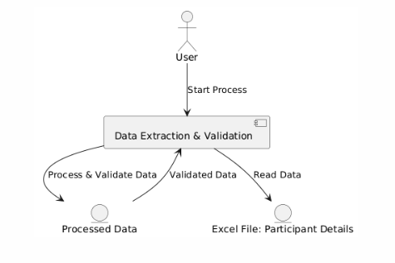
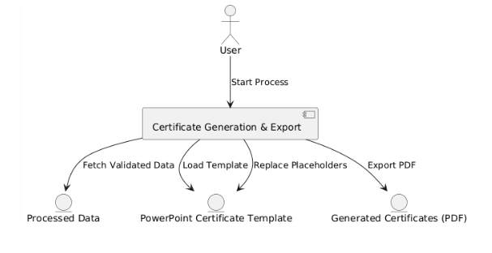
Functional Description
Module 1: Data Extraction and Processing
This module reads participant details from
the Excel file and processes the data for
use in certificate generation.
Module 2: Certificate Generation,Export
This module generates certificates using the
PowerPoint template and exports them as
PDF files.

Slide 10
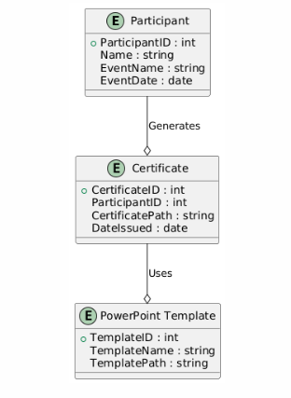
Table Design
Entity Relationship Diagram

Slide 11
Process Design
Main Process: Certificate Generation Automation
Start Process: User triggers the RPA automation.
Extract Participant Data:
  Read Excel File: The bot reads participant details from the Excel sheet.
  Validate Data: Ensures all required fields are correctly filled.
Process Data:
  Prepare Participant Data: Formats the data for certificate generation.
Generate Certificate:
  Open PowerPoint Template: Opens the predefined certificate template.
  Replace Placeholders: Fills in participant details into the template.
  Save as PDF: Saves the filled certificate as a PDF.
Repeat for All Participants: Generates certificates for all participants in the Excel file.
End Process: Process concludes once all certificates are created and saved.

Slide 12
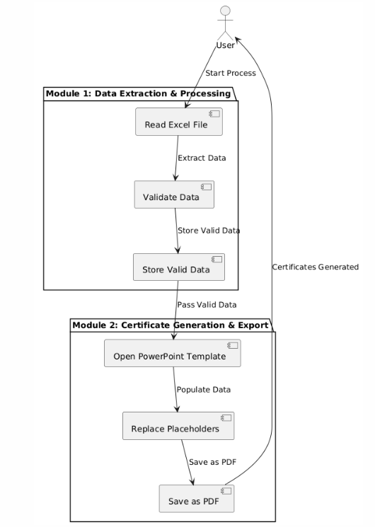
Process Design

Slide 13
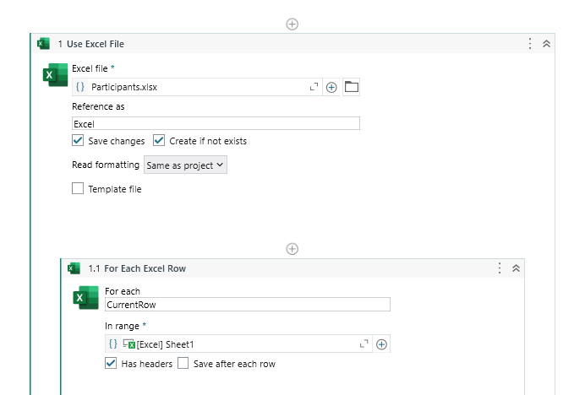
Implementation
Module 1:Module 1 extracts participant data from an Excel file using Read Range validates the data for completeness and correctness, and stores valid entries in a new DataTable. This cleaned data is then passed to Module 2 for certificate generation.

Slide 14
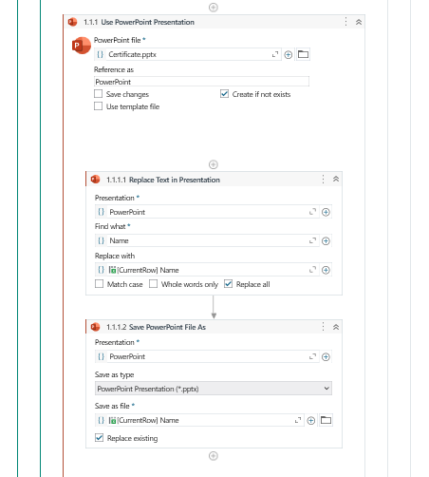
Implementation
Module 2:Module 2 uses the validated participant data to populate placeholders in a PowerPoint certificate template. It opens the template, replaces placeholders with participant details (e.g., name, event), and saves the customized certificate as a PDF for each participant.

Slide 15
Testing
Testing for this project involves verifying the correct functionality of both Module 1 and Module 2. For Module 1, tests are conducted to ensure that participant data is accurately read from the Excel file, properly validated, and that only valid data is passed to Module 2. This includes checking for missing or incorrect entries. In Module 2, the tests focus on verifying that the PowerPoint template is correctly opened, placeholders are accurately replaced with participant information, and the certificate is successfully saved as a PDF. The system is tested with multiple participants to ensure that it can handle different data inputs and generate the correct certificates for each. Additionally, edge cases such as incomplete or malformed data in the Excel file are tested to ensure proper error handling and logging.

Slide 16
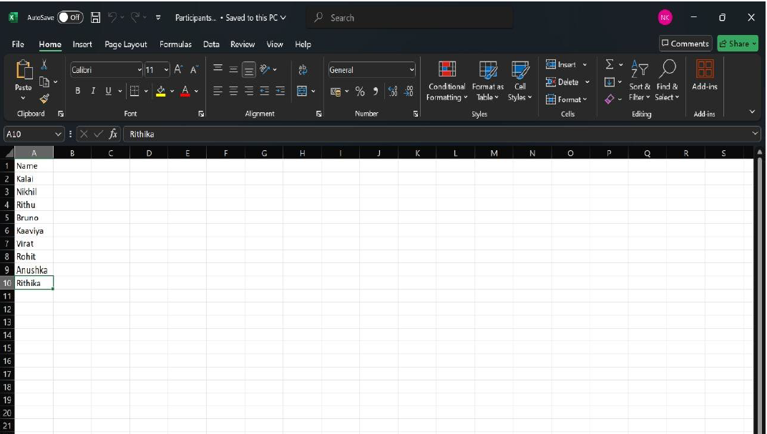
Testing
Participants Excel sheet

Slide 17
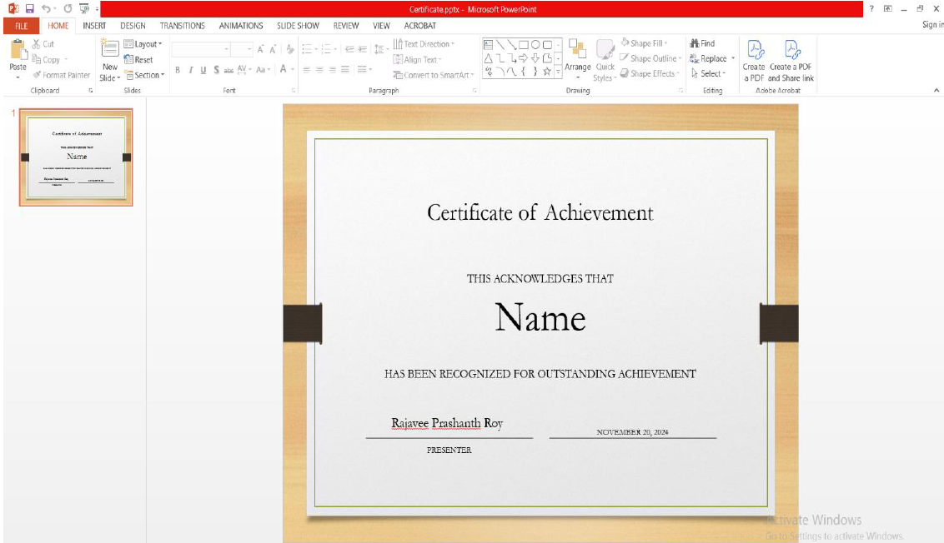
Testing
Certificates template

Slide 18
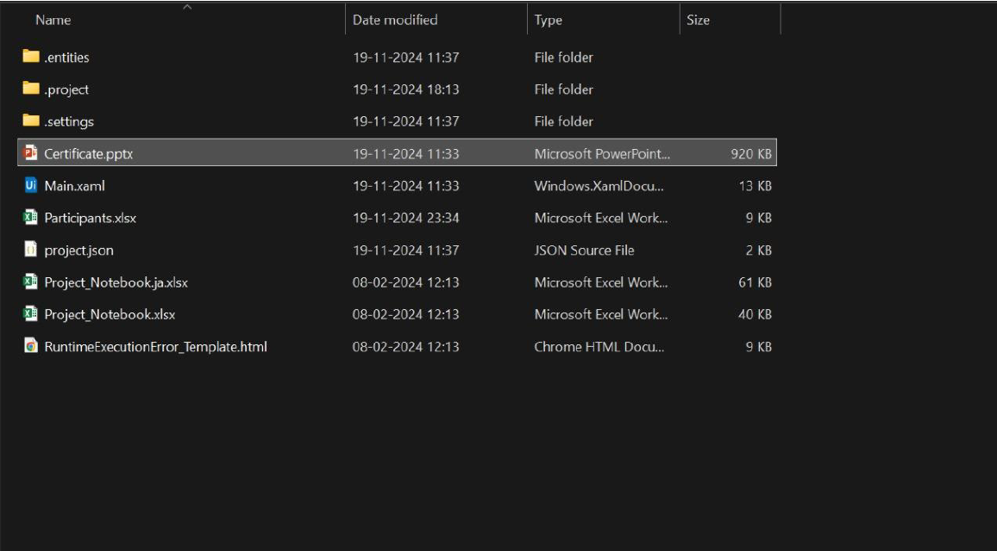
Testing
Before Debugging

Slide 19
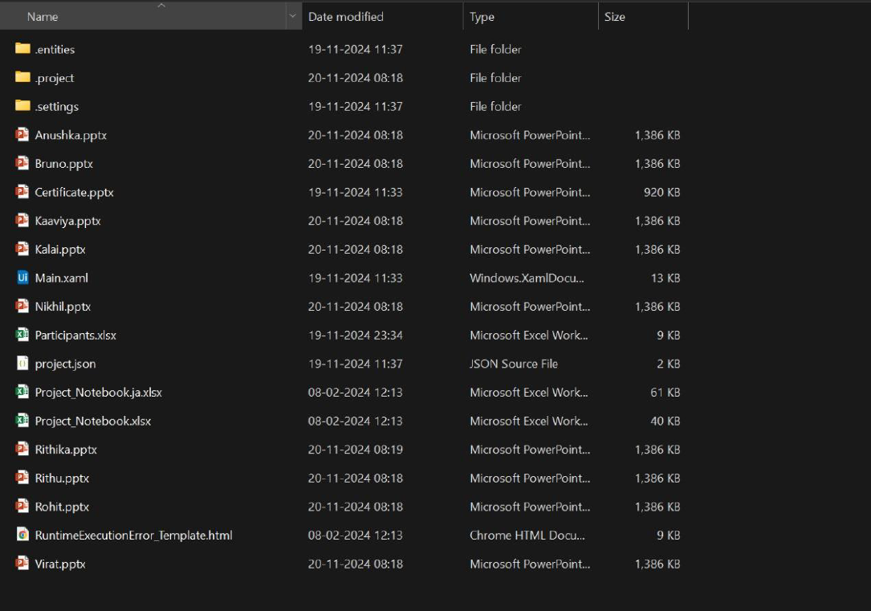
Testing
Certificates successfully generated

Slide 20
Conclusions
In conclusion, the Excel-to-Certificate Automation project successfully streamlines the process of generating customized certificates for participants. By automating the extraction, validation, and processing of data from Excel and integrating it with a PowerPoint certificate template, the system reduces manual effort and the potential for errors. The project’s modular approach, with separate modules for data processing and certificate generation, ensures flexibility and ease of maintenance. This solution not only saves time but also improves efficiency, making it ideal for handling large volumes of participant data and generating certificates quickly and accurately. The use of RPA with UiPath enhances automation, ensuring scalability and consistency in certificate generation.

Slide 21
Future Enhancement
Dynamic Template Support: Allow users to upload different certificate templates, enabling customization for various events or certificate types.
Error Handling and Reporting: Implement more robust error handling to manage exceptions such as invalid data formats, missing files, or failed PDF generation. An automated error reporting system could notify users of issues.
Bulk Email Integration: Add functionality to automatically send generated certificates to participants via email, streamlining the distribution process.
Web Interface: Develop a web-based interface where users can upload participant data, choose templates, and download the generated certificates, making the system more accessible.

Slide 22
IEEE Paper
Title:Applications, Tools and Technologies of Robotic Process Automation in Various Industries.
Authors: Shagun Sharma; Anjali Kataria; Jasminder Kaur Sandhu
The paper "Applications, Tools and Technologies of Robotic Process Automation in Various Industries" explores how RPA is applied across diverse sectors, including finance, healthcare, and business administration, particularly for automating repetitive tasks like document generation and data entry. This paper discusses the various RPA tools and technologies and their benefits in reducing operational costs and improving efficiency.

Slide 23
References
Siddiqui, K., & Raj, D. (2021). "Applications, Tools, and Technologies of Robotic Process Automation in Various Industries.”
Avasarala, R., & Sharma, P. (2020). "Robotic Process Automation: A Scientific and Industrial Systematic Mapping Study.”
Pereira, F., & Meirelles, R. (2020). "Automation in Business: RPA for Document Processing and Generation.”
Wang, X., & Li, J. (2019). "Robotic Process Automation for Document Management."

Slide 24
Queries

Slide 25
Demonstration

Slide 26
Thank You

